Slide 1
Survey for Partner Involvement - Slovenia
from 1 July to 15 July 2020
Introduction to the
Interreg CENTRAL EUROPE Programme 2021-2027
Interreg CENTRAL EUROPE Managing Authority/Joint Secretariat

Slide 2
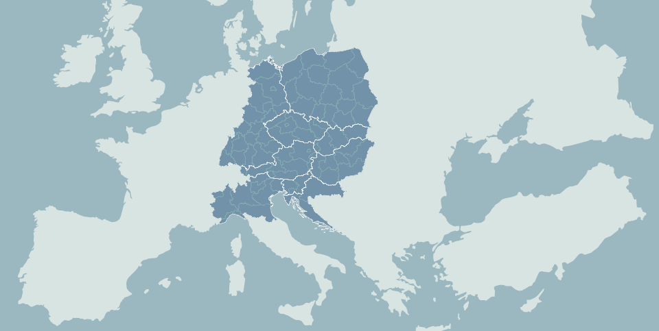
Interreg transnational cooperation in central Europe
> 2 million inhabitants
1 to 2 million inhabitants
Capital cities < 1 million in.
9 countries
8 capital cities
Warsaw
7 cities above 1 million inhabitants
Berlin
146 million inhabitants
Prague
Vienna
Bratislava
246 million EUR ERDF (2014-20)
Munich
138 projects approved
Budapest
Milan
Ljubljana
1330+ partners involved
Zagreb
Notes:
CE is an area at the heart of EU home of 146 mln inhabitants
Its CE TN programme is one of the transnational programmes of EU CoPol 2014-2020.
It has a long story of cooperation in the north-south and east-west axes along the former iron curtain

Slide 3
The new Interreg CE Programme: an inclusive approach
Transnational
Survey
+
National activities
Interreg CENTRAL EUROPE Programme 2021-2027
National
Needs of territories
Programme contents
Priorities and SOs
Actions
Target groups
Regional
Local

Slide 4
Not yet decided
Programme structure in June 2020
4 funding priorities
9 specific objectives
Actions to be designed and target groups to be specified
Notes:
To mention orally that
Aim of the survey is to collect ideas on possible topics and actions to be addressed within each SO → to fill in the programme structure with life
Some topics are not visible in the headings of the SOs → Read the exec summary!

Slide 5
Shaping Interreg CE 2021-27: next steps
June, July 2020
Partner dialogues
(transnational survey + national events)
Drafting the programme
December 2020
Approval of the programme
Summer 2021
Launch of the first call

Slide 6
Where to find information
www.interreg-central.eu/CE21-27
General information, relevant documents and updates on the future
Interreg CENTRAL EUROPE Programme 2021-2027

